Slide 1
EU's Single Use Plastics and Fishing Gear Directive
Workshop on Single-use Plastic – 14 March 2019
Sàndor Szelekovszky – EU Delegation to Israel

Slide 2
EU' Circular Economy Package
The Package adopted on 2 December 2015 – timing is not an incident
Positive and clear signal to partners but also for investors – Europe is the best place to grow a sustainable and environmentally-friendly business
Aims: transition towards a circular economy to boost global competitiveness, foster sustainable economic growth and generate new jobs and to enhance more innovative ways of producing and consuming
"It's the economy, stupid"

Slide 3
EU's Plastic Strategy – adopted by European Commision in January 2018
Transforming the way products are designed, produced, used and recycled in the EU, through:
Making recycling profitable for business (e.g. by means of new packaging rules, creating demand for recycled plastic etc.)
Curb plastic waste (e.g. rules on single-use plastic etc.)
Stop littering at the sea (e.g. rules on port facilities)
Drive investment and innovation (e.g. recyclable plastic)
Spur change across the world – we need partners for global solutions

Slide 4
Implementation of the Plastics Strategy: Reducing Marine Litter
Action on intentionally added micro-plastics
Referred to the European Chemical Agency for possible restriction in the Framework of REACH. ECHA has published its restriction dossier stating that health and environmental risks posed by intentionally added micro-plastics justify an EU-wide restriction. ECHA’s Scientific Committees will now review the dossier and an EU-wide restriction could be in place by mid-2020.
Revision of the Port Reception Facilities Directive
Includes measures to ensure that waste generated on ships or gathered at sea is returned to land and adequately managed. We reached political agreement in December 2018.
Waste Framework Directive, as amended in 2018
Requires Member States to take measures aimed at halting the generation of marine litter and measures to prevent, reduce and clean-up litter, as well as to identify products that are the main sources of marine litter.
Directive on Single Use Plastics and Fishing Gear
Political agreement reached in December 2018. EP end March. Council adoption mid-April. Implementation within two years.

Slide 5
Why this Directive? Why this Focus?
70% covered of all marine litter: top 10 SUP (43%) + fishing gear (27%)

Slide 6
10 most found items
Ranking | Item
1 | Drinks bottles, caps and lids
2 | Cigarette butts
3 | Cotton buds sticks
4 | Crisp packets / sweet wrappers
5 | Sanitary applications
6 | Plastic bags
7 | Cutlery, straws and stirrers
8 | Drinks cups and cup lids
9 | Balloons and balloon sticks
10 | Food containers including fast food packaging

Slide 7
The Directive will ensure the reduction of the impact of certain plastic products on the environment
items with available sustainable alternatives
promote less harmful alternatives: market bans
prevention measures: design requirements, consumption reduction, consumer information
items with no clear alternatives
better waste management: separate collection, extended producer responsibility + clean-up

Slide 8
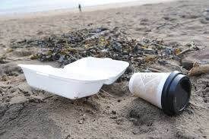
Consumption reduction (Article 4)
Ambitious and sustained reduction of plastic food containers and cups (including covers and lids).
National marketing restrictions for products with options to substitute.
Food containers
Cups for beverages
Member States choose the appropriate measures
Consumption reduction targets
Economic instruments
Increase the availability of alternatives e.g. re-usable
Items not provided free of charge
Notes:
e.g. by setting national reduction targets, making alternative products available at the point of sale, or ensuring that single-use plastic products cannot be provided free of charge

Slide 9
Market restriction - bans (Article 5)
Market restrictions or bans on products with readily available alternatives (both single & multi use):
Cotton bud sticks
Cutlery
Plates
Straws
Beverage stirrers
Sticks for balloons

Slide 10
Product design requirements (Article 6)
Tethered caps and lids for all beverage containers and bottles up to 3 litres (5 years after the entry into force of the Directive)
Binding target of at least 25% of recycled plastic for beverage bottles by 2025
As of 2030, all single use plastic bottles will have to respect a target of at least 30% of recycled content.
Notes:
In bold the changes to the EC proposal

Slide 11
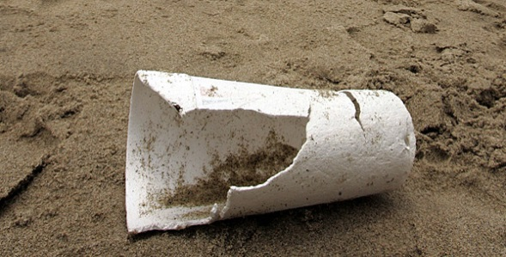
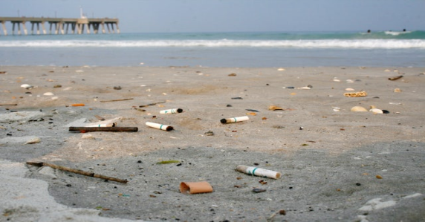
Marking Requirements (Article 7)
For tobacco products with filters, cups for beverages, wet wipes and sanitary towels clear and harmonized labelling will be required. For cups, the label will be on the product itself.
The label will indicate how waste should be disposed, the presence of plastics in the product and the resulting negative environmental impact.
Notes:
In bold the changes to the EC proposal

Slide 12
Extended producer responsibility (Article 8)
For plastic products such as food and beverage containers, bottles, cups, packets and wrappers, light weight carrier bags and tobacco products with filters producers will have to contribute to the costs of:
- waste prevention (awareness raising)
waste management (collection and treatment costs of waste in public areas)
litter clean-up
data gathering.
For wet wipes and balloons, only the waste prevention and litter clean-up costs should be covered.

Slide 13
Provisions on Fishing gear
Extended Producer Responsibility (EPR) schemes to cover the costs of separate collection and further treatment of waste from fishing gear
Member States will set a national collection targets and monitor fishing gear waste with a view to a later EU-wide collection target
Work on harmonized standards for the circular design of fishing gear.

Slide 14
Separate collection (Article 9)
Separate collection target for plastic beverage bottles to be achieved through EPR or through deposit refund schemes
→ by 2025 – 77%
→ by 2029 – 90%
Supporting high quality recyclates and uptake of secondary raw materials
Supporting plastic packaging recycling target of 55% by 2030

Slide 15
Next steps:
Evaluation of the Directive after 6 years (Article 15)
To enhance further efforts and to draw on experiences in implementation regular monitoring and in addition a comprehensive Review will take place, including:
Reporting by the European Commission on implementation
Reviewing the list of SUPs in the Annex
Setting quantitative consumption reduction targets for food containers and beverage cups
Establishing binding collection rates for fishing gear

Slide 16
(Next steps 2) Evaluation of biodegradability
Assessment of the scientific and technical progress concerning criteria for biodegradability in the marine environment applicable to single-use plastic products within the scope of this directive and their single-use substitutes
This is key to evaluate the efficiency of the measures taken and to recalibrate action.

Slide 17
Impacts & costs
Reduction of plastics littering | > 50% reduction of plastics littering from top 10 SUP items
Avoid CO2 emissions | Eq. 3.4 mn tonnes
Avoid environmental damage | Eq. of 23 bn benefit
Savings for consumers | ≈ €6.5 bn
Jobs creation | ≈ 30 000
Waste management costs | ≈ €0.8 bn
Cost for business: compliance, commercial washing multi-use items & refill schemes | ≈ €2.4 bn

Slide 18
Implementation of the Plastics Strategy - Pledging Campaign
The Commission received so far over 60 pledges from plastics recyclers, industry associations and brand owners mainly for PET packaging.
It is estimated that at least 10 million tons of recycled plastics could be supplied by 2025 if the pledges are fully delivered.
However the demand side (utilizers) only pledged for 6.5 million tons more targeted action will be needed on this end to promote the up-take of recycled plastic.

Slide 19
Circular Plastics Alliance
The aim of the Circular Plastics Alliance, is to improve the economics and quality of plastics recycling in Europe. The Alliance will in particular strengthen the match between supply and demand for recycled plastics which is identified as a key obstacle to a well-functioning EU market of recycled plastics.
The Circular Plastics Alliance will help achieving the target of at least 10 million tons of recycled plastics finding their way into new products on the EU market by 2025 as set in the European Strategy for Plastics.
In the course of 2019 the Alliance will come up with Roadmap on implementation.
The Alliance will also monitor the delivery of the pledges and set up a common monitoring system.

Slide 20
Circular Plastic Alliance (2)
The Alliance was launched in December 2018 with key industry stakeholders covering the full plastic value chain to reduce litter and to increase the share if recycled plastic
This Platform is to encourage cooperation and dialogue between market operators both on supply and demand side covering waste collectors, primary producers, converters, brand owners and retailers in particular in packaging, construction and automotive sectors
Main operational objectives:
- Fostering coordinated actions and investments by stakeholders
- Reporting on obstacles which may hamper efforts
- Monitoring progress made and identifying gaps.

Slide 21
Few Preliminary Conclusions
- The overall Strategic Framework is best to start with
- Clear rules on individual sectors (plastic, construction/energy) should follow to mobilize targeted efforts
- Create economically attractive conditions is essential
- But regulatory pressure on operators is equally important
- Creating a comprehensive platforms ("Alliance") for stakeholders
- Reaching out, informing the wider public also necessary
- International cooperation – sine qua non condition
The EU is ready to further engage!

Slide 22
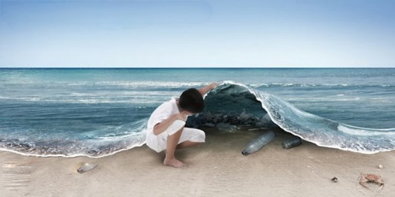
Learn more about this Directive, the plastics strategy and the circular economy:
http://ec.europa.eu/environment/circular-economy/index_en.htm

